Slide 1

Exploring the impact of Transfer Learning and Semi Supervised GANs for Tumor Classification In Medical Imaging
FYP Research Project Defense
Supervisor: Dr. M. Irfan Uddin
S.No. | Student Name | GPA
S1 | Hussam Umer | 3.75
S2 | NIL | N/A
S3 | NIL | N/A
Institute of Computing

Slide 2
Table of Contents
Research Title
Research Questions
Problem Statement
Background
The Proposed Architecture
Flow Chart
Dataset Selection
Tools & Technologies

Slide 3
Research Title
Exploring the impact of Transfer
Learning and Semi Supervised
GAN for Tumor Classification

Slide 4
Research Questions
How does transfer learning impact the performance of CycleGAN in generating synthetic medical images for tumor classification?
What are the computational requirements and training time differences between TL-SCycleGAN and traditional CycleGAN for generating synthetic medical images?
Can TL-SCycleGAN effectively overcome domain shift issues when applied to different medical imaging modalities for tumor classification?
How does the performance of TL-SCycleGAN compare with other state-of-the-art methods for synthetic data generation in medical imaging?

Slide 5
Problem Statement
In recent research,
Identification of benign and malignant tumors in medical imaging is challenging
Existing deep learning approaches require large labeled datasets for effective training
Imbalance between benign and malignant cases further complicates classification
Data diversity and realism, which means generating diverse and realistic synthetic tumor images

Slide 6
Base Research Papers
Title | Author | Date | Model
Transfer Learning-Based Semi-Supervised Generative Adversarial Network for Malaria Classification | Ibrar Amin , Saima Hassan , Samir Brahim Belhaouari, and Muhammad Hamza Azam | 2022 | TL-S-GAN
Unpaired Image-to-Image Translation using Cycle-Consistent Adversarial Networks | Jun-Yan Zhu, Taesung Park, Phillip Isola, Alexie A.Afros | 2017 | Cycle- GAN
Deep Residual Learning for Image Recognition | Kaiming He; Xiangyu Zhang; Shaoqing Ren; Jian Sun | 2016 | ResNET-50
Very deep convolutional networks for large-scale image recognition | Karen Simonyan & Andrew Zisserman | 2015 | VGG-16

Slide 7
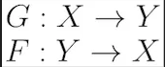
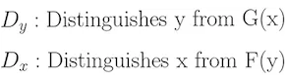
Background
Cycle GAN is a Generative Adversarial Network (GAN) that uses two generators and two discriminators.
One generator G, it convert images from the X domain to the Y domain. The other generator is called F, and converts images from Y to X.
Each generator has a corresponding discriminator, which attempts to tell apart its synthesized images from real ones.

Slide 8
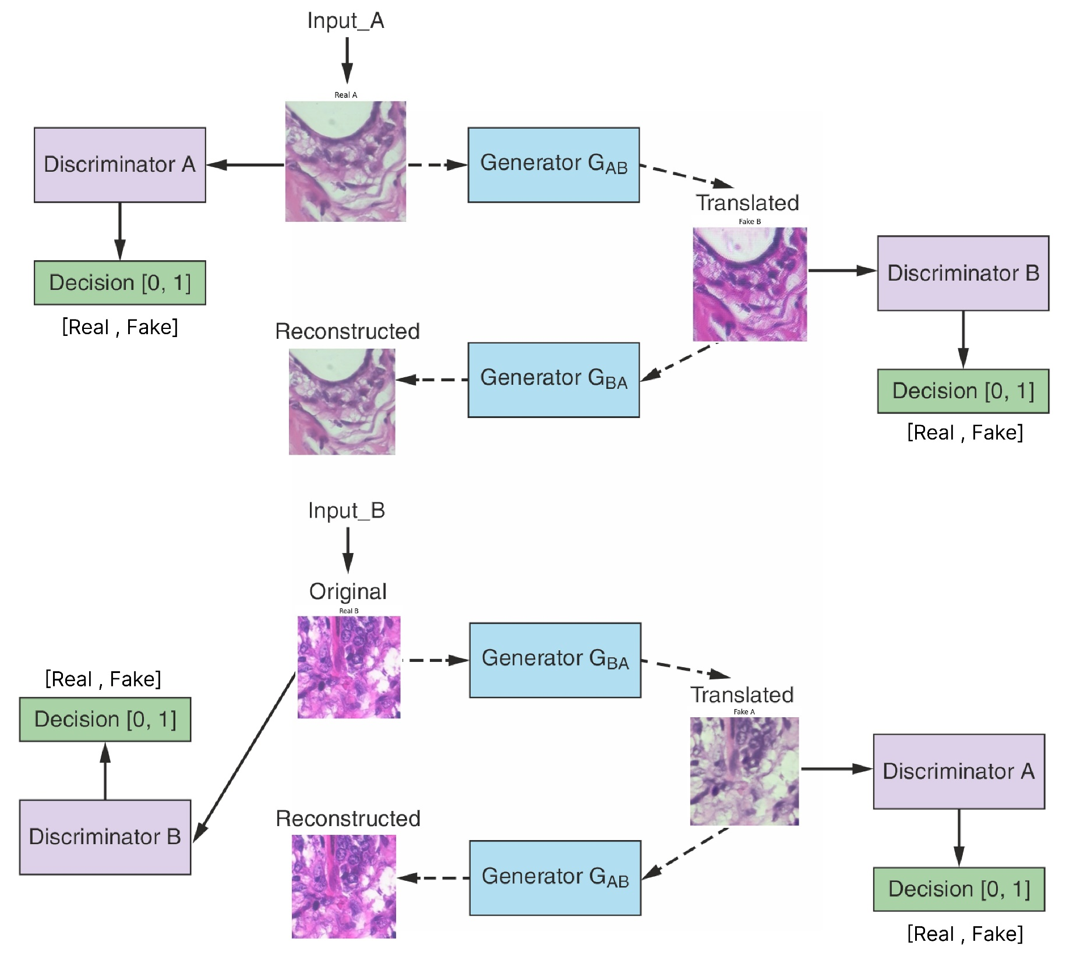
Working Flow(Cycle GAN)

Slide 9
Architecture
Generator Architecture:
Encoder
Transformation Blocks
Decoder
Discriminator Architecture:
PatchGAN

Slide 10
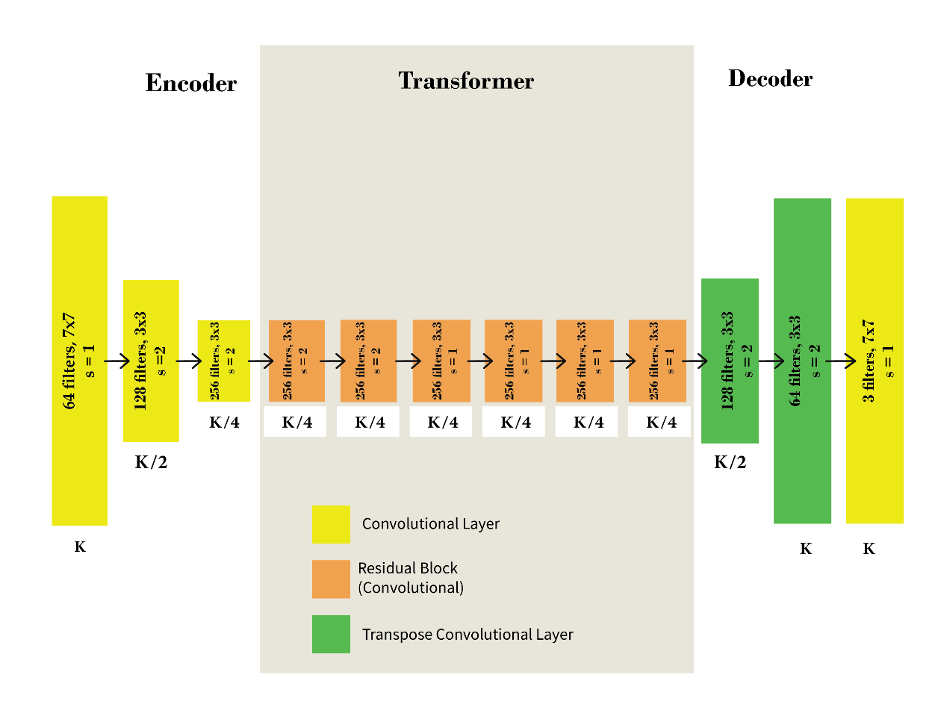
Architecture(Generator)

Slide 11
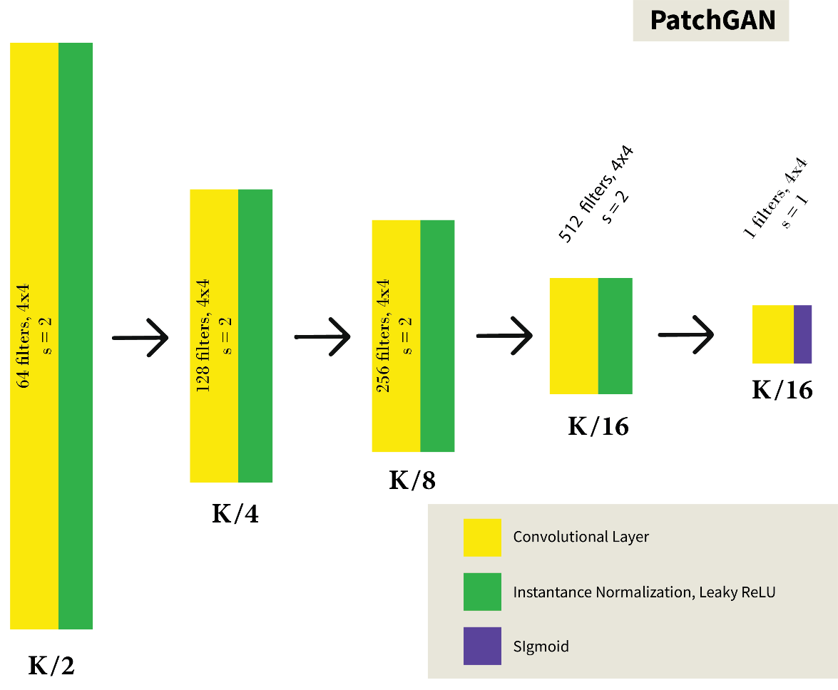
Architecture(Discriminator)

Slide 12
The Proposed Architecture
1. ResNET-50:
Initial Layer
Pooling Layer
Residual Block
Bottleneck Design
Block Stacking
Avg. Pooling Layer
Fully connected Layer

Slide 13
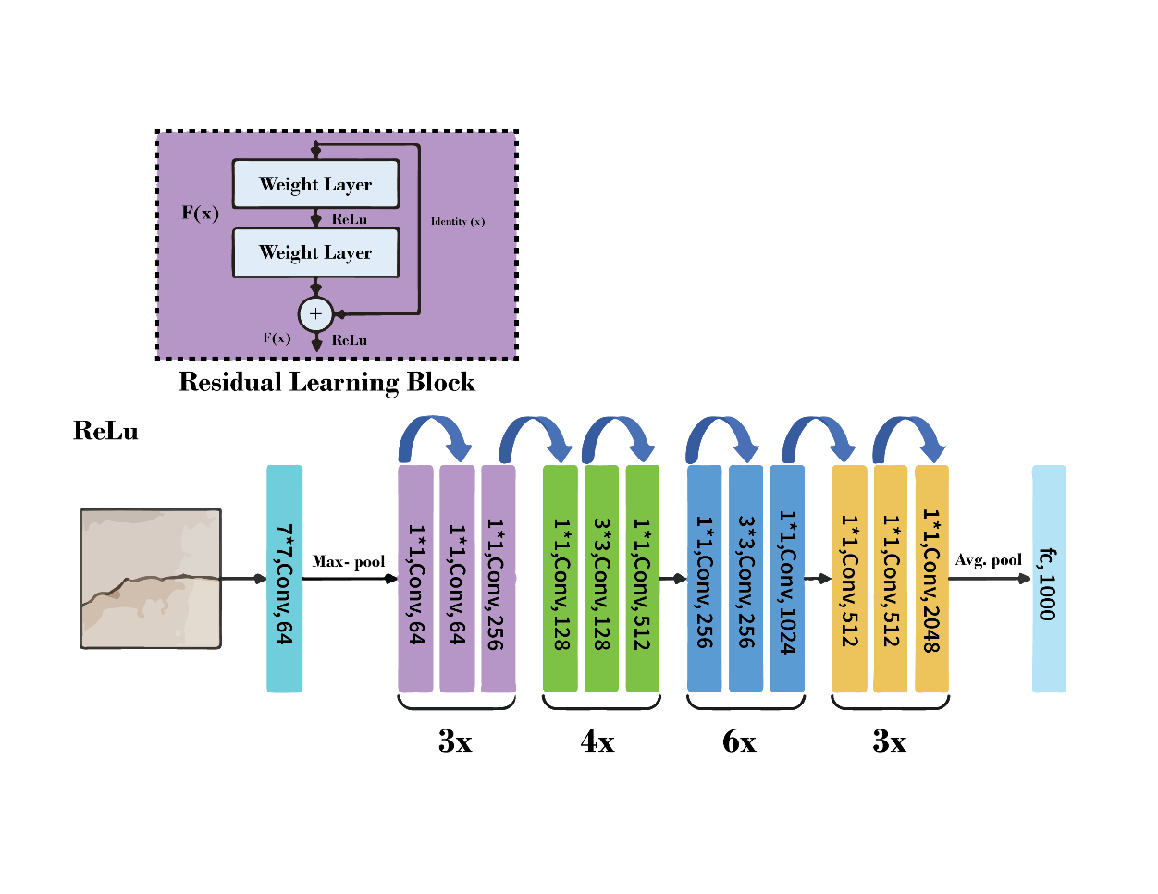
ResNET-50

Slide 14
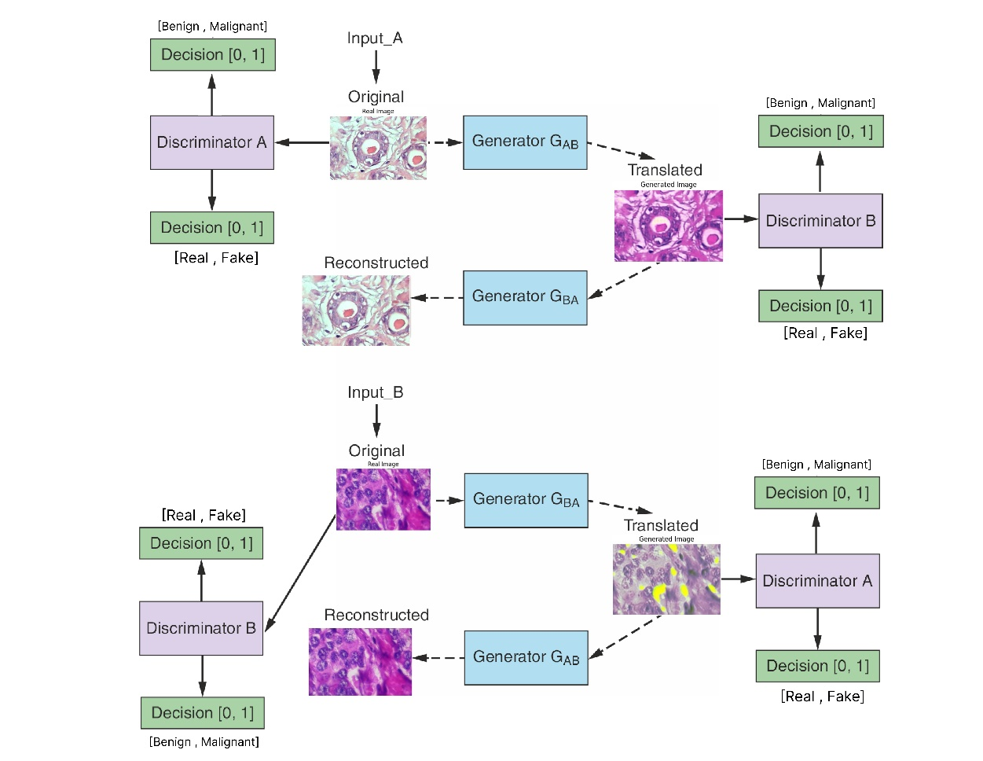
Working Flow(ResNET- 50 Cycle GAN)

Slide 15
The Proposed Architecture
2. VGG-16:
Convolutional Layers
Pooling Layer
Fully Connected Layers
Block Structure
Architecture Depth
Design Philosophy

Slide 16
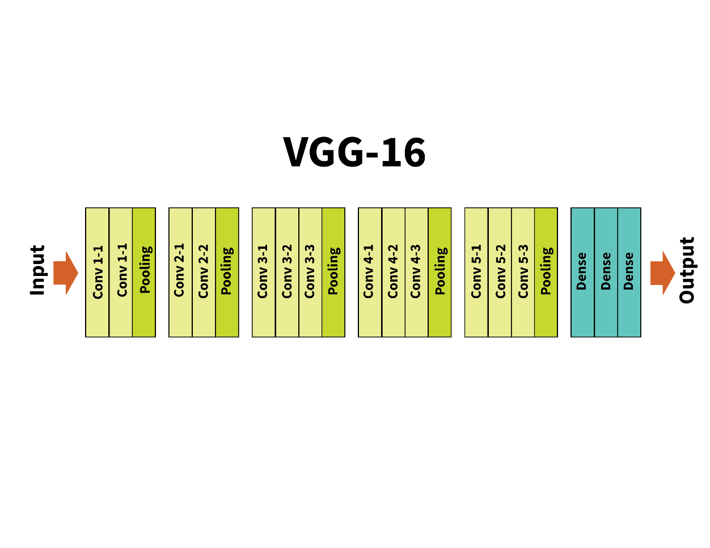
VGG-16

Slide 17
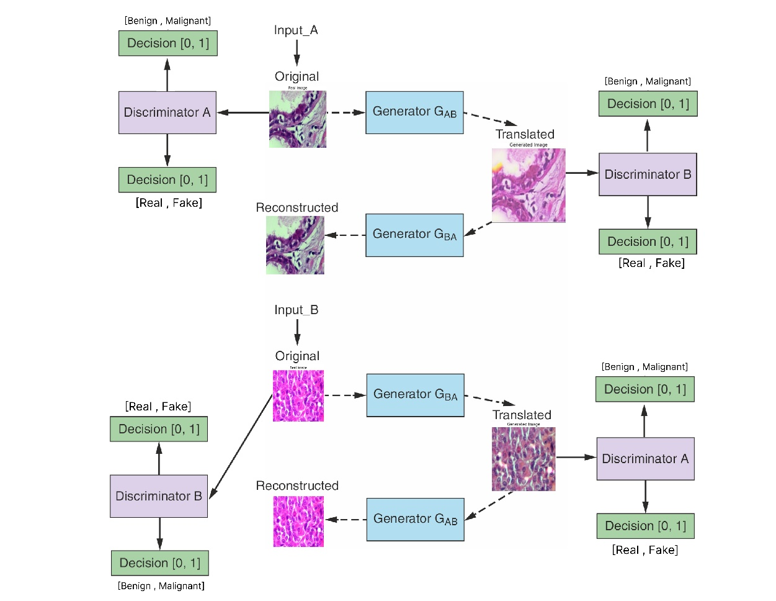
Working Flow(VGG-16 Cycle GAN)

Slide 18
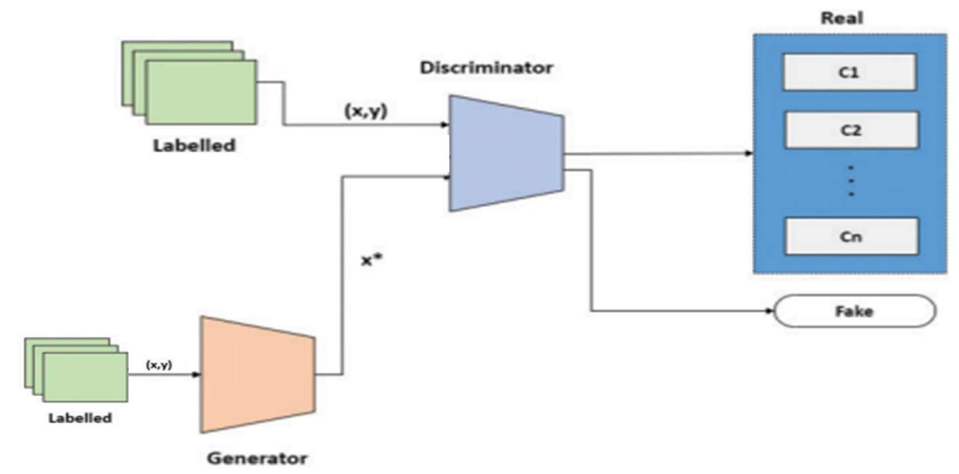
Semi-Supervision

Slide 19
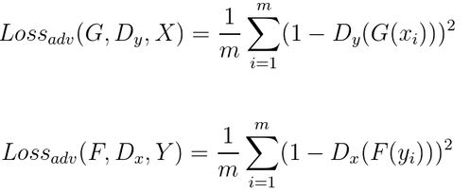
The objective Function
There are two components to the CycleGAN objective function, an adversarial loss and a cycle consistency loss. Both are essential to getting good results.
1. Adversarial Loss :
The adversarial loss measures how well the generator can fool the discriminator.
The objective is to minimize this loss, which encourages the generator to generate realistic data samples.

Slide 20
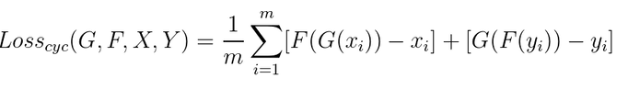
The objective Function(Cont.)
2. Cycle-Consistency Loss:
The cycle-consistency loss is introduced to enforce that the output generated by the generator, when passed through another generator in the opposite direction, should reconstruct the original input.
It enforces that F(G(x)) ≈ x and G(F(y)) ≈ y.

Slide 21
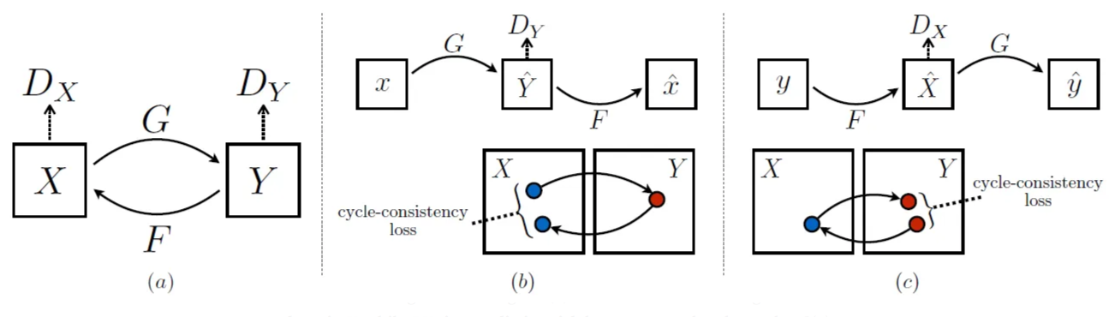
The objective Function(Cont.)

Slide 22
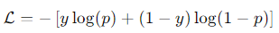
The objective Function(Cont.)
3. Cross Entropy Loss:
The cross entropy loss quantifies the difference between the predicted probability distribution and the actual distribution.
For binary classification, it is defined as:
Where:
y is the actual label (0 or 1).
p is the predicted probability of the positive class (1).

Slide 23
Dataset
BreakHis Histology Slides
Total Images = 210
Training = 200
Benign = 100
Malignant = 100
Testing = 20
Benign = 10
Malignant = 10
Zoom Range = 400x.

Slide 24
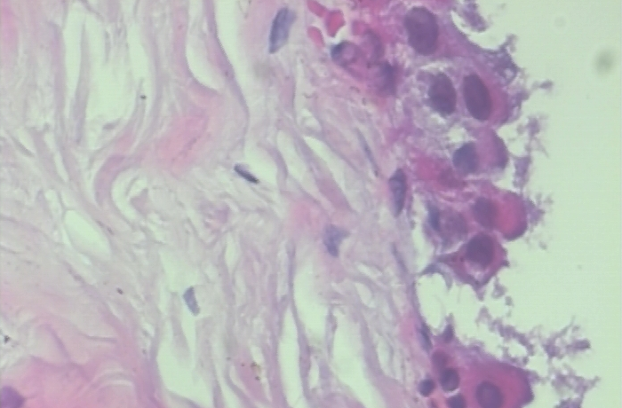
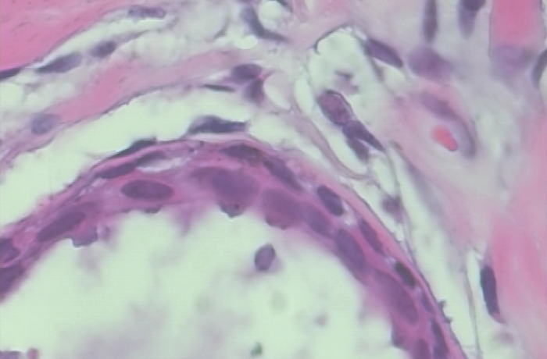
Dataset(Examples)

Slide 25
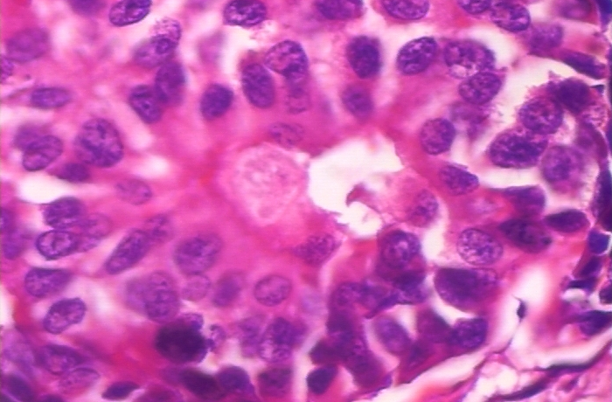
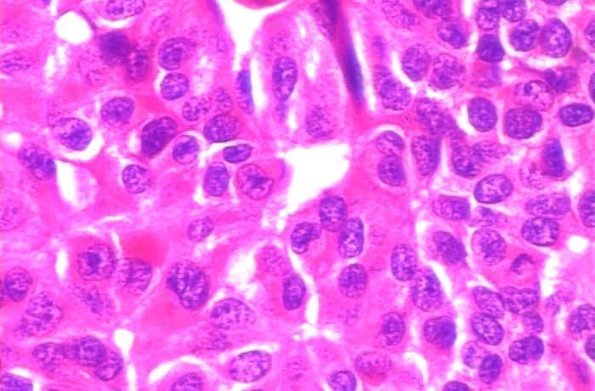
Dataset(Examples)

Slide 26
Evaluation Metrics
Classification Metrics
Accuracy
Precision
Recall
F1 Score
Rating and Preference Judgment.
Rating Image Quality
Real/Fake

Slide 27
Evaluation Metrics(Cont.)
Fully Convolutional Network Metrics
Intersection-Over-Union(IOU)
Average-Per-Pixel Accuracy
Average-Per-Class Accuracy
Image Quality Measures
Structural Similarity Index Matrix(SSIM)
Peak-Signal-Noise Ratio(PSNR)
Mean Squared Error(MSE)

Slide 28
Results
Classification Metrics :
Model | Accuracy | Precision | Recall | F1 Score
VGG-16 CycleGAN | 0.5000 | 0.5000 | 1.0000 | 0.67
ResNET-50 CycleGAN | 0.9500 | 0.9036 | 1.0 | 0.95
Simple CycleGAN | 0.70 | 1.0 | 0.400 | 0.57

Slide 29
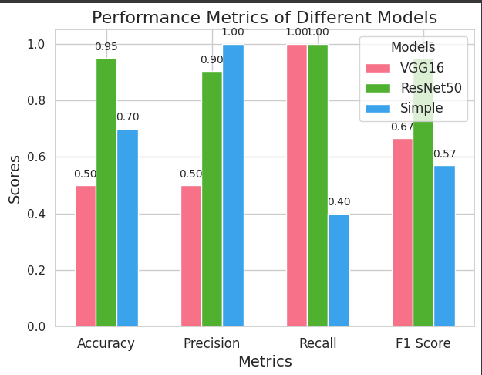
Classification Results

Slide 30
Results(Cont.)
FCN Results:
Model | Intersection over Union (IoU) | Average Per-Pixel Accuracy | Average Per-Class Accuracy
Simple CycleGAN | 0.3091 | 0.9426 | 0.4653
VGG-16 CycleGAN | 0.6787 | 0.9547 | 0.8374
ResNET-50 CycleGAN | 0.2603 | 0.8962 | 0.4578

Slide 31
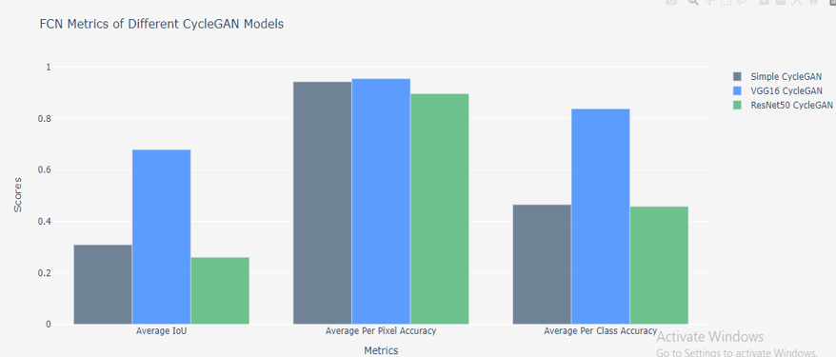
FCN Results:

Slide 32
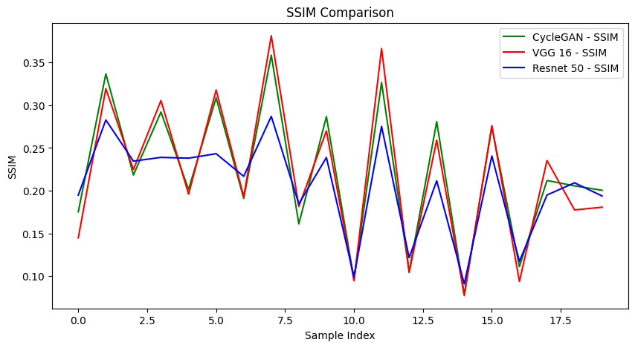
Results(Cont.)
Image Quality Measures :
SSIM:

Slide 33
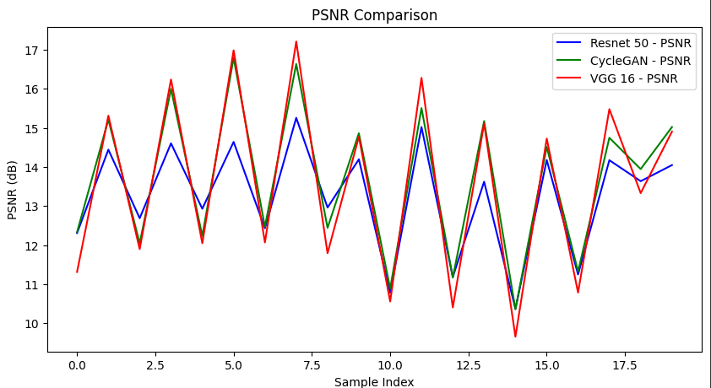
Image Quality Measures(cont.)
PSNR :

Slide 34
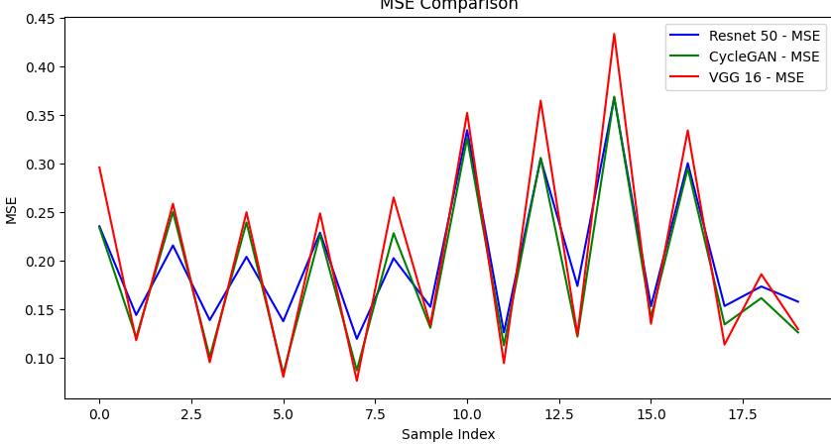
Image Quality Measures(Cont.)
MSE :

Slide 35
Results(Cont.)
Rating and Preference Judgment :
Model | Average Image Quality | Real/Fake(%)
Simple CycleGAN | 3.51 | 0.80
VGG16 CycleGAN | 4.2 | 0.95
ResNet50 CycleGAN | 2.85 | 0.50
Real Images | 3.9 | 0.90

Slide 36
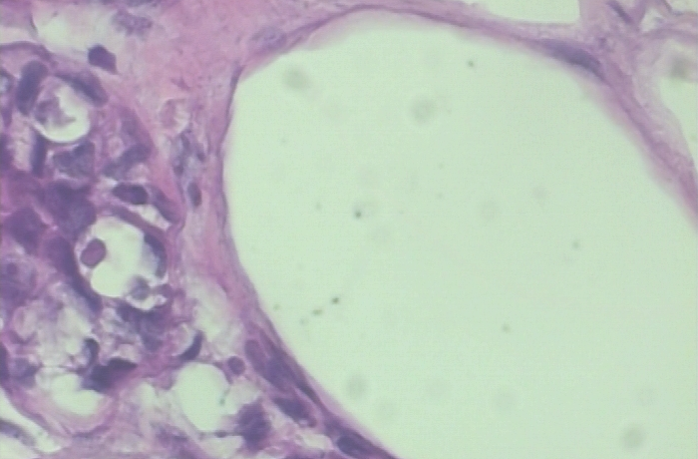
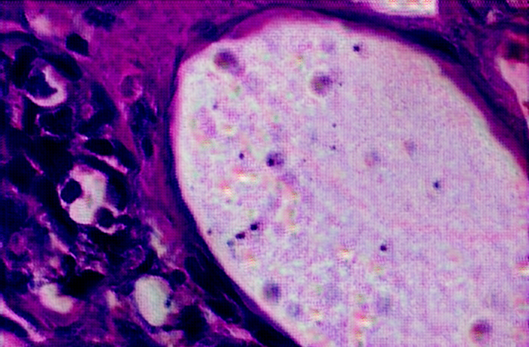
Real Vs Generated Examples
Simple Cycle GAN:

Slide 37
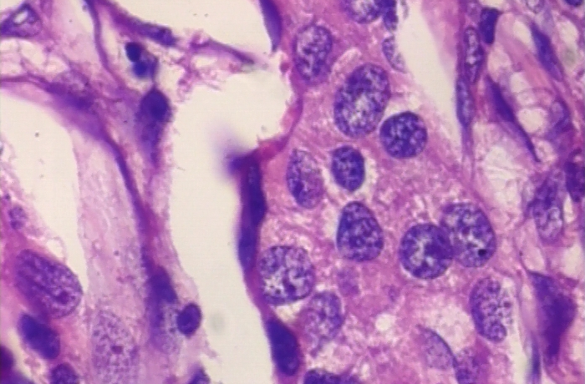
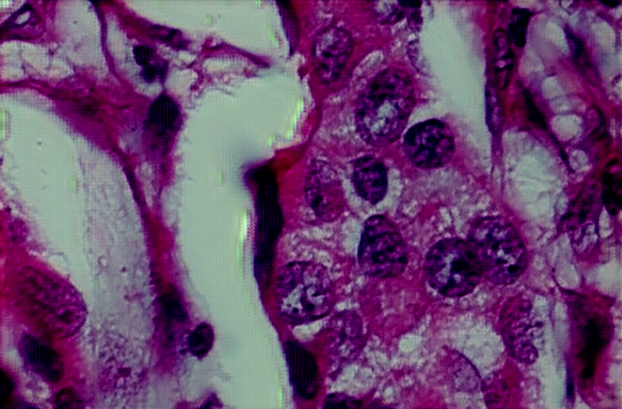
Real Vs Generated Examples

Slide 38
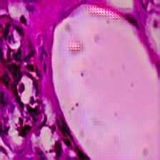
Real Vs Generated Examples
VGG-16 Cycle GAN:

Slide 39
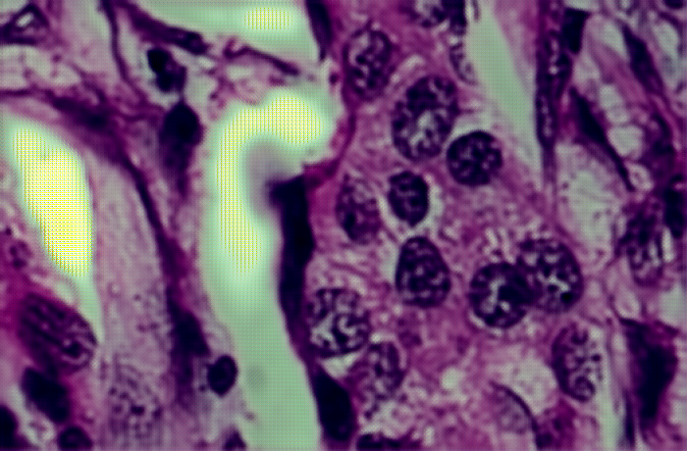
Real Vs Generated Examples

Slide 40
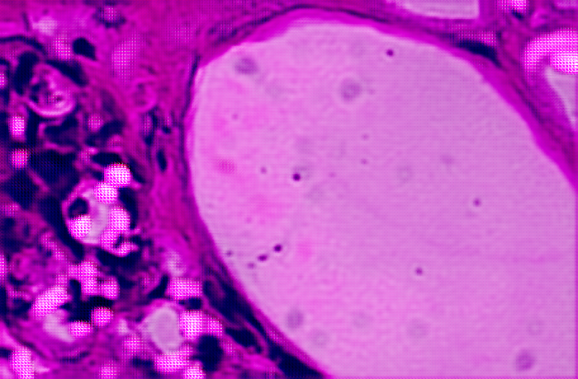
Real Vs Generated Examples
ResNET-50 :

Slide 41
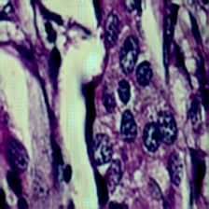
Real Vs Generated Examples

Slide 42
Tools/Simulators :
Python
Pytorch
Scikit Learn
Matplotlib
Seaborn
Google Colab
Google Drive
Pycharm
Anaconda Jupyter Notebook
BreakHis Dataset

Slide 43
Limitations :
The generated images often contain noticeable noise and artifacts, affecting quality and realism.
Significant computational power is required, limiting accessibility for researchers with constrained resources.
Training deep models is time-intensive, often taking several hours to days.
A substantial amount of labeled data is still needed, which is time-consuming and costly to acquire.
The models may not generalize well across different medical imaging modalities and tumor types, needing further validation.

Slide 44
Thank You

